Slide 1

LLM Engineering
MASTER AI & LARGE LANGUAGE MODELS

Slide 2

WEEK 3 DAY 5
Today we build confidence
What you can now do
Confidently code with Frontier Models
Build a multi-modal AI Assistant with Tools
Use Hugging Face pipelines, tokenizers and models
After today you will be able to
Confidently work with tokenizers and models
Run inference on open-source models
Implement an LLM solution combining Frontier and open-source models

Slide 3



Create a solution that makes meeting minutes
Take an audio recording of a meeting, and generate minutes and actions
Use a Frontier model to convert the audio to text
Use an open source model to generate minutes
Stream back results and show in Markdown

Slide 4
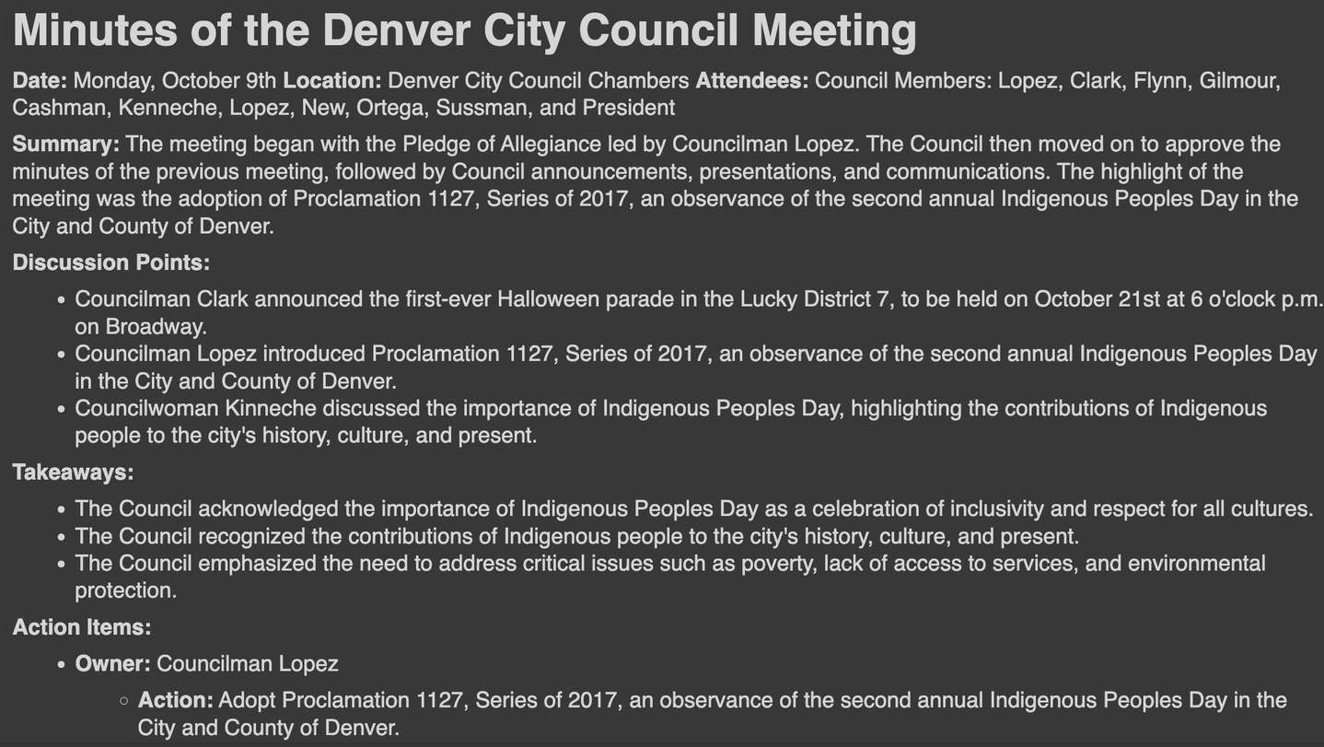
THE RESULTS
A solution combining Frontier and open-source

Slide 5

YOUR CHALLENGE
And now - an important business challenge
Generating Synthetic Data
Write models that can generate datasets
Use a variety of models and prompts for diverse outputs
Create a Gradio UI for your product
Why is this useful
Applies to almost any business area - you can use this in your day job and home projects
Notes:
Video URL: https://videos.pexels.com/video-files/1793334/1793334-hd_1920_1080_30fps.mp4

Slide 6

WEEK 3 COMPLETE
You've acquired pro skills!
What you can now do
Confidently code with Frontier Models
Build a multi-modal AI Assistant with Tools
Build an LLM solution combining frontier and open-source models
After next week you'll be able to:
Pick the right LLM for the task at hand
Compare LLMs using Leaderboards and Arenas
Generate code using Frontier and Open-source models

